Slide 1
Deploy the B2Bi APIs
on IBM Sterling Integrator.
Arpit Jain

Slide 2
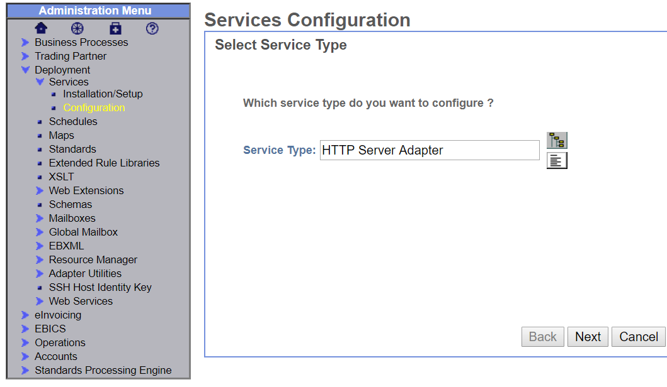
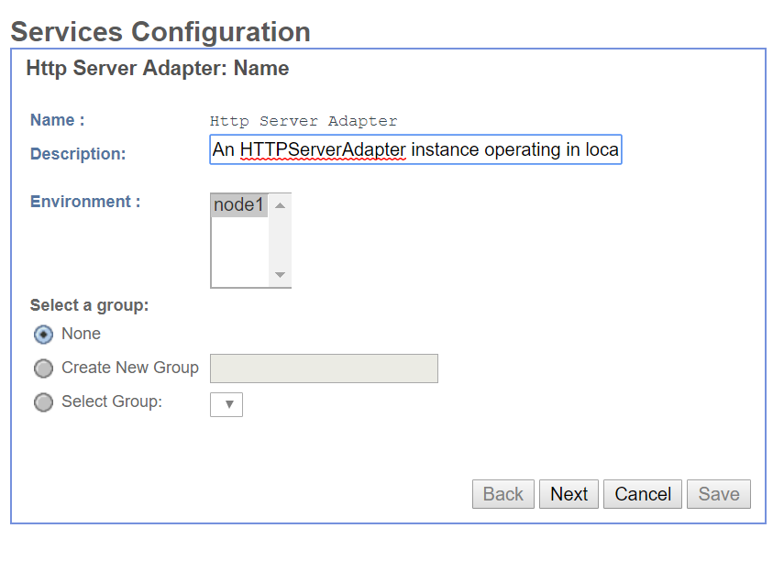
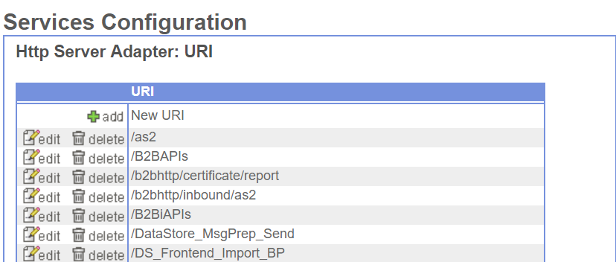
Step 1 : Create a new Http Adapter Service. And add a new URI for the B2Bi APIs

Slide 3
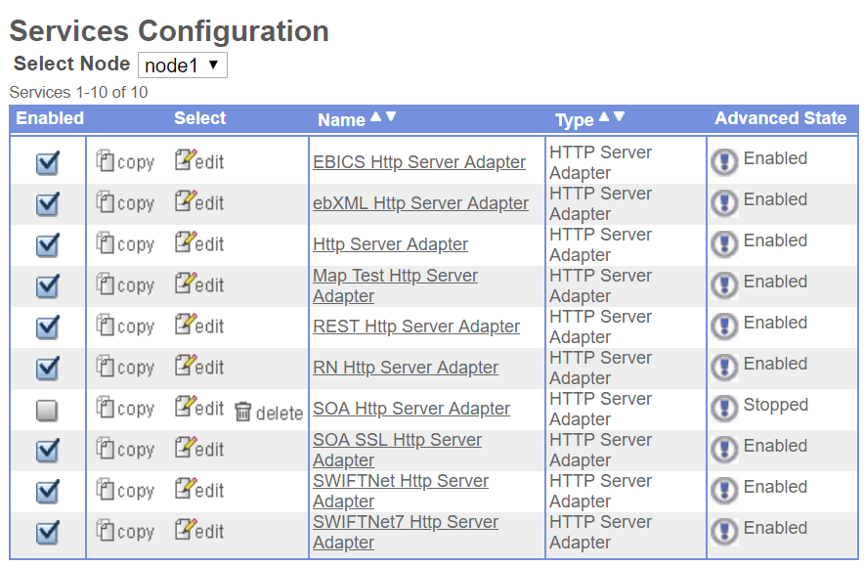
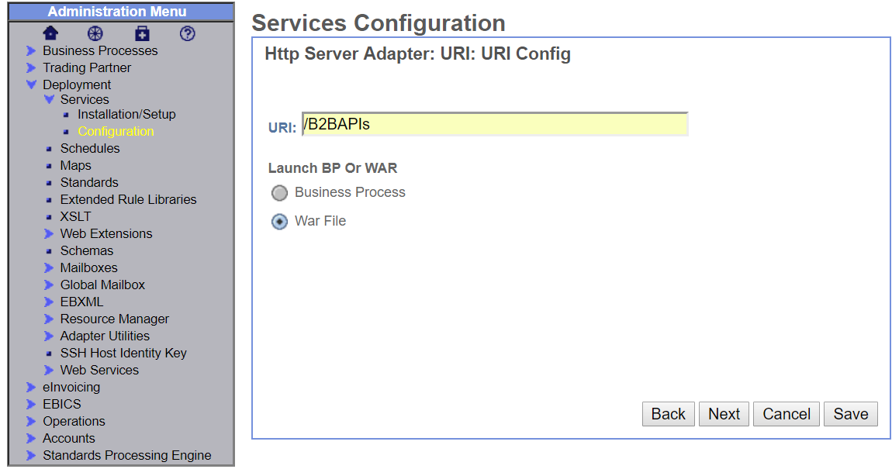
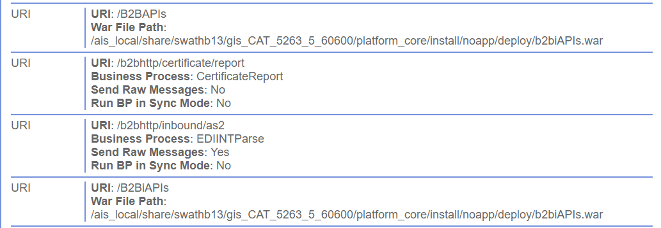
Step 2 : Bind the New URI to the B2Bi WAR Source file.

Slide 4
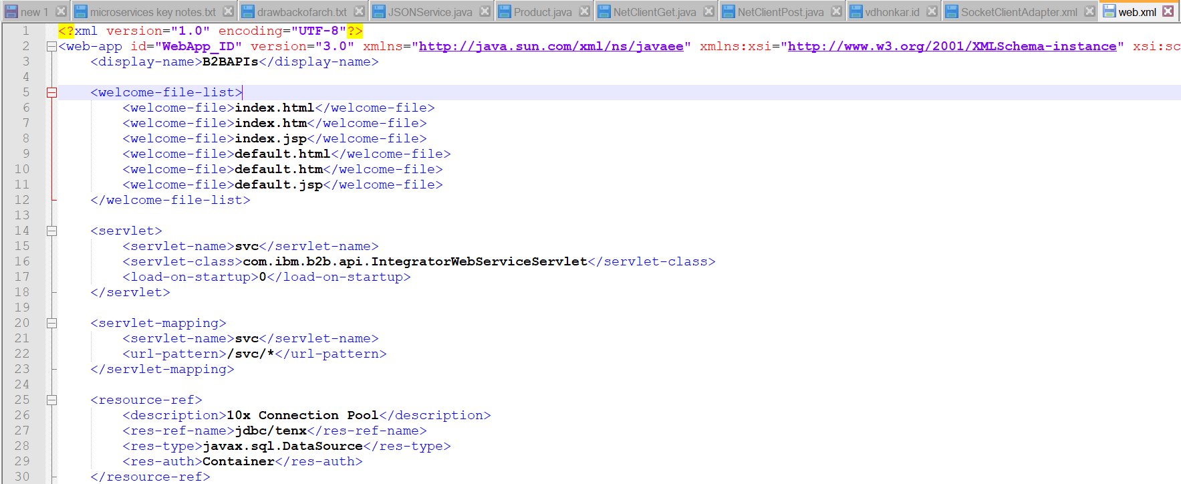
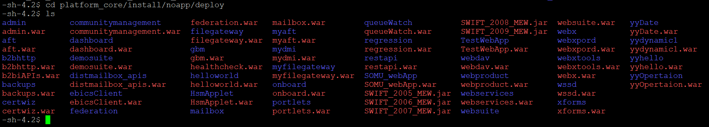
Step 3 : Update the Web.xml file to set the base/default page to open.
Step 4 : Copy the WAR file to the Deploy Directory.

Slide 5
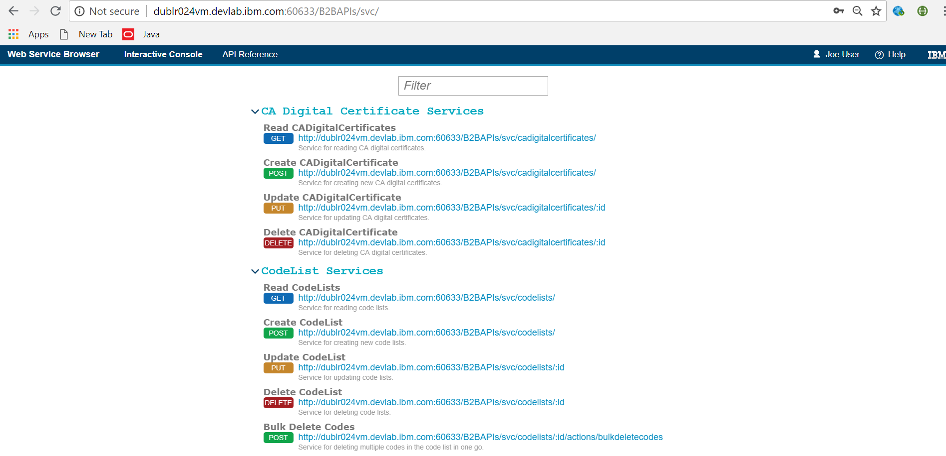
Step 5 : Check the Deployed B2Bi WAR on the specified URI

